Slide 1






Fake vs Real News Classification NLP Machine Learning Project
Bosco & Frank

Slide 2

Project Objective
Build end-to-end NLP pipeline to:
Process raw noisy text
Extract meaningful linguistic features
Convert text into numerical vectors
Train machine learning classifiers
Predict labels for unseen news headlines

Slide 3


PIPELINE
Raw Text → Cleaning → Tokenization → Feature Engineering → Vectorization → Modeling

Slide 4



Dataset Analysis
Training Dataset
Fake: 51.5%
Real: 48.5%
34,152 labeled headlines
Headlines average 75 characters, ~12 tokens

Slide 5

Preprocessing
Normalization
Structural Cleaning
Tokenization
Lemmatization
StopWord

Slide 6

FEATURE ENGINEERING
VECTORIZATION
BAG OF WORDS
TF-IDF
Headline Patterns in Fake News
More exclamation marks
More emotionally charged word
More uppercase emphasis

Slide 7
TF-IDF Vectorization
TF-IDF turns text into meaningful numerical features by emphasizing important words and downplaying common ones

Slide 8



MODELS TRAINING
Linear SVM
Logistic Regression
Random Forest
XGBoost

Slide 9
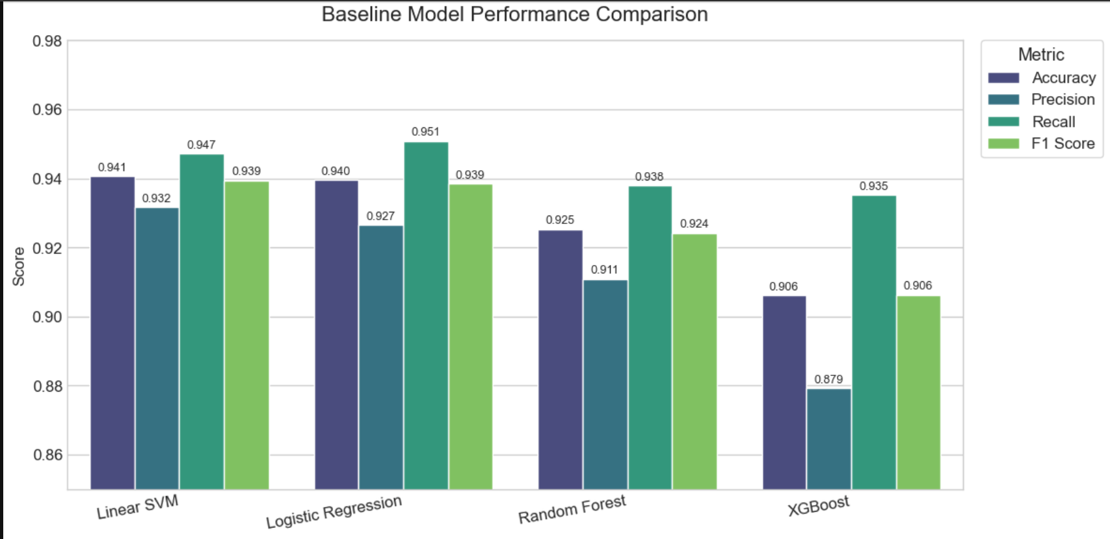
Performance Comparison of Models

Slide 10
Hyperparameter Tuning
Logistic Regression: C (regularization strength), Solver (liblinear, saga), Class Weight (balanced), Max Iterations increase for convergence)
Linear SVM: C (soft-margin penalty), Loss Function (hinge / squared hinge), Class Weight, Max Iterations (for stability)
Random Forest Classifier: n_estimators (number of trees), max_depth, max_features, min_samples_split, min_samples_leaf

Slide 11
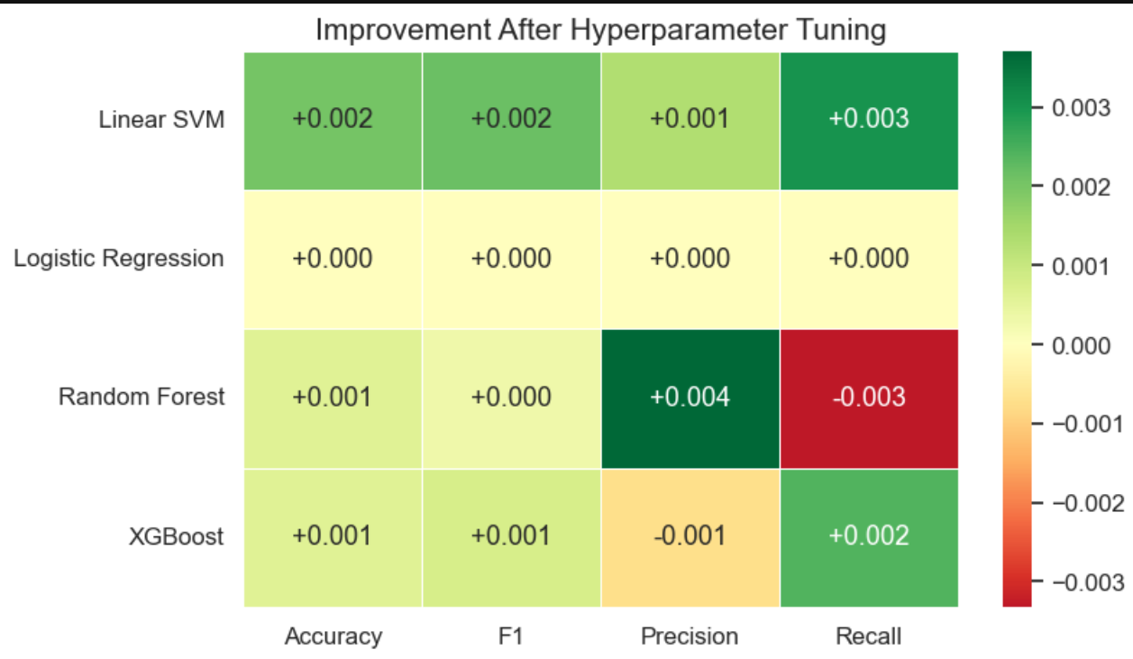
Hyperparameter Tuning
SVM benefited the most, gaining improvements across all metrics
Logistic Regression saw minimal changes
Random Forest and XGBoost saw slight improvements but not enough to outperform linear models

Slide 12
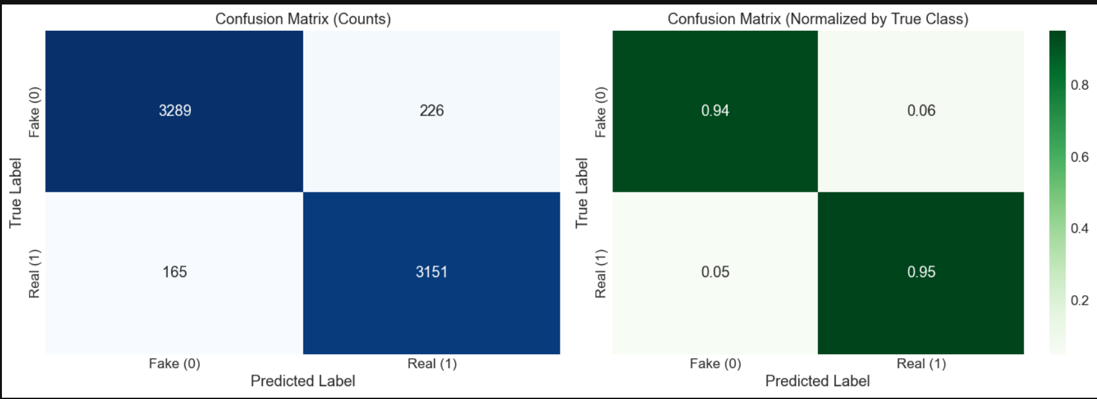
Model Testing & Evaluation (Linear SVM)
Fake News (0) Class
Correctly predicted Fake: 3289
ncorrectly predicted as Real: 226¶
Model correctly identifies Fake news ~94% of the time
Real News (1) Class
Correctly predicted Real: 3151
Incorrectly predicted as Fake: 165
Model correctly identifies Real news ~95% of the time.

Slide 13
CONSCLUSION
Linear SVM demonstrates strong predictive ability on training and test data with minimal misclassification, confirming it as the ideal model for deployment.

Slide 14
Thank you!

